Slide 1
CCGC 5004 Database Systems
Document store

Slide 2
Objectives
JSON Documents
Tables with document store

Slide 3
JSON Introduction
JSON – sort for JavaScript Object Notation
It is a format for sharing data, derived from JavaScript but is used in many languages, Python, Ruby, PHP, and Java
The structure of a JSON document does not have to be defined in advance

Slide 4
Syntax and Structure
A JSON object is a key-value data format that is typically rendered in curly braces
A JSON object looks something like this:
{
“first_name” : “Sammy”,
“ last_name” : “ Shark”,
“location” : “Ocean”,
“online” : true,
“followers” : 987
}
The example shown shows the format is generally setup with two curly braces or brackets like this, { } on either end of it
There are key-value pairs populating the space between the curly brackets

Slide 5
Syntax and Structure
Key-value pairs have a colon between them as in “key” : “value”
Each key-value pair is separated by a comma, so the middle of a JSON looks like this:
“key” : “value”,
“key” : “value”,
“key” : “value”
In the example of the previous slide, the first key-value pair is “first_name” : “Sammy”
JSON keys are on the left side of the colon
They need to be wrapped in double quotation marks as is “key” and can be any valid string
The key can include whitespaces as is “first name”, can be harder to access when programming so it is best to use underscores as in “first_name”

Slide 6
Syntax and Structure
JSON values are found to the right of the colon
These need to be on of 6 simple data types:
Strings
Numbers
Objects
Arrays
Booleans (true or false)
Null
At a broader level, values can be made up the complex data types of JSON object or array
Each of the data types that are passed as values into JSON will maintain their own syntax, so stings are in quotes, but numbers are not

Slide 7
Syntax and Structure
JSON could be written on one line, typically it is expanded over several lines
Writing JSON over multiple lines makes it more readable
Especially when dealing with a large data set
JSON ignores whitespace between elements, so you can space out the colons and key-value pairs to make the data more human readable
{
“first_name” : “Sammy”,
“ last_name” : “ Shark”,
“location” : “Ocean”
}

Slide 8
Working with Complex Types in JSON
So far we have looked at JSON in its simplest terms
Now we want to look at JSON in more complex terms with hierarchical that can be composed of nested objects and arrays
JSON objects can store nested objects in addition to nested arrays
These objects and arrays will be passed as the value for each of the users, with its own nested keys of “username” and “location” that relate to each of the users
Look at the first nested JSON object on the next page:

Slide 9
Working with Complex Types in JSON
{
“Sammy” : {
“username” : “SammyShark”,
“location” : “Indian Ocean”,
“online” : “true”,
“followers” : 987
},
“Jessie” : {
“username” : “JessieOctopus”,
“location” : “Pacific Ocean”,
“online” : “false”,
“followers” : 432
},
“drew” : {
“username” : “DrewSquid”,
“location” : “IAtlantic Ocean”,
“online” : “false”,
“followers” : 321
},
“jamie” : {
“username” : “JamieMantisShrimp”,
“location” : “Pacific Ocean”,
“online” : “true”,
“followers” : 654
}
}

Slide 10
Working with Complex Types in JSON
In the example on the previous page, curly brackets are used throughout to form a nested JSON object with associated username, and location data for each of the 4 users
Just like any other value, when using objects, commas are used to separate elements

Slide 11
Nested Arrays
Data can also be nested within the JSON format by using JavaScript arrays that are passed as a value
JavaScript uses square brackets [ ] on either end of this array type
Arrays are ordered collections and can contain values of differing data types
We may use an array when we are dealing with a lot of data that can be easily grouped together
Consider the example of a single user with various websites and social media profiles associated with the single user
On the next slide the nested array is highlighted for Sammy

Slide 12
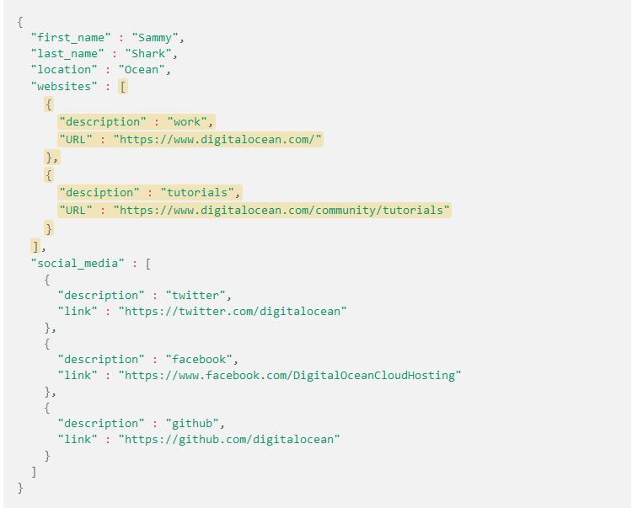
Nested Arrays

Slide 13
Relational Tables
The X DevAPI of MySQL can also work with relational tables
Each relational table is associated with a storage engine
The default engine is InnoDB for SQL and it is also the default engine with the X DevAPI of MySQL for document collections
To confirm the schema that is assigned to the global variable, issue db
CRUD Operation | Description | Document Store | Relational Data
CREATE | Add new item/object | collection.add() | table.insert()
READ | Retrieve/search for data | collection.find() | table.select()
UPDATE | Modify data | collection.modify() | table.update()
DELETE | Remove item/object | collection.remove() | table.delete()
Going to focus this week on the Relational Data commands

Slide 14
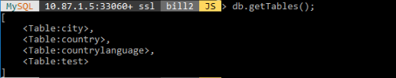
Relational Tables
To display all relational tables in your schema use the getTables() method on the db object
You may notice that the result is shown as JSON in a key – value pair

Slide 15
Basic Table Operations
You can use the insert() method with the values () method to insert records into an existing relational table
The insert() method accepts individual columns or all columns in the table
Use one or more values() methods to specify the values to be inserted
Insert a Complete Record
To insert a complete record, pass to the insert() method all columns of the table
Then pass the to the values() method one value for each column in the table
Add a new record to the city table, in your schema, press enter twice after entering the details

Slide 16
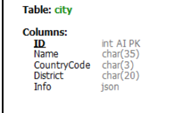
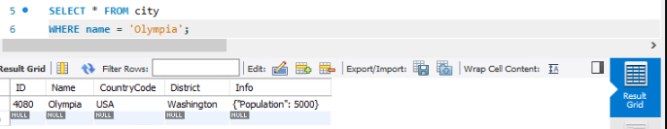
Basic Table Operations
Notice the table CITY has a JSON column for POPULATION
In Workbench displayed the record inserted through mysqlsh, you can see the Info column displayed as a KEY:VALUE

Slide 17

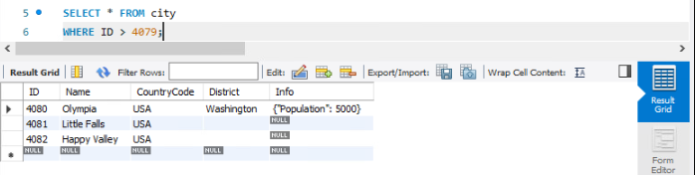
Basic Table Operations
Can INSERT a record with only partial columns with the insert() method
Here two records are entered through with he insert() method with multiple values methods
Verify that the two new rows were inserted to the table

Slide 18
SELECT Tables
You can use the select() method to query and return records from a table in a database
The X DevAPI provides additional methods to use with the select() method to filter and sort records
MySQL provides the following operators to specify search conditions:
OR (||), AND (&&), XOR, IS< NOT, BETWEEN, IN, LIKE, !=, <>, >, >=, <, <=, &, |, <<, >>, +, -, *, /, ~ and %

Slide 19
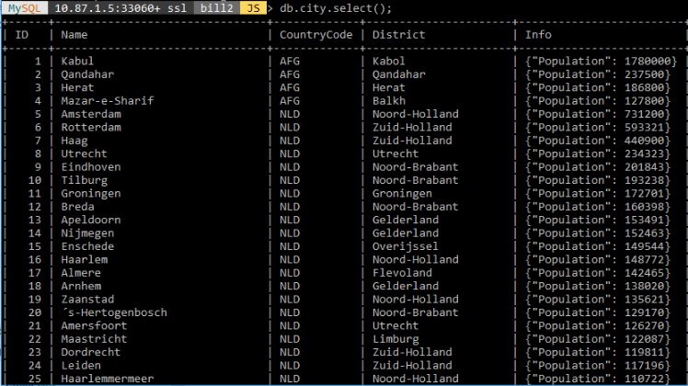
SELECT All Records
You can issue a query that returns all records from an existing table, use the select() method without specifying search conditions
Note: Limit use of the empty select() method to interactive statements. Always use explicit column-name selections in your application code

Slide 20
SELECT All Records
On the previous slide all the records are displayed, it does not only display a set amount of records
Hence the statement that says you should not do this method, also displays all columns, should be selective to only display what you need to see

Slide 21
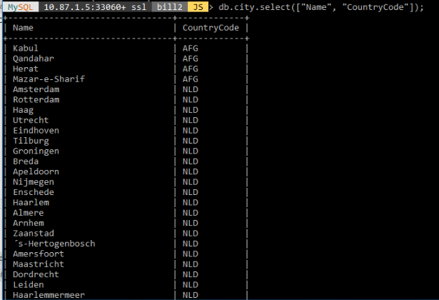
Filter Searches
To issue a query that returns a set of table columns, use the select() method and specify the columns to return between square brackets
This query returns the Name and CounutryCode columns from the City table

Slide 22
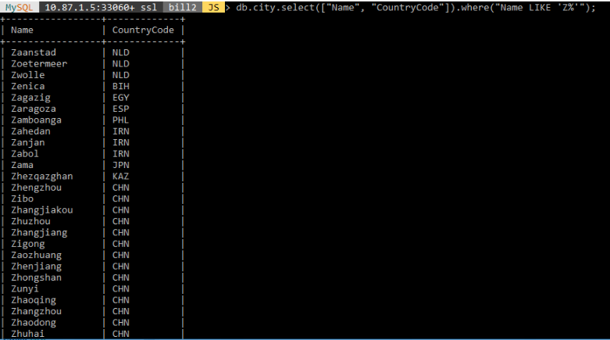
Filter Searches
To issue a query that returns matching specific search conditions, use the where() method to include these conditions
The following example returns the names and country codes of the cities that start with the letter”Z”

Slide 23
Filter Searches
You can separate a value from the search condition by using the bind() method.
For example, instead of using “Name LIKE ‘Z%’” as the condition, substitute a named placeholder consisting of a : (colon) followed by a name that begins with a letter, such as name
Then include the placeholder and a value in the bind() method
Output is shown on next slide

Slide 24
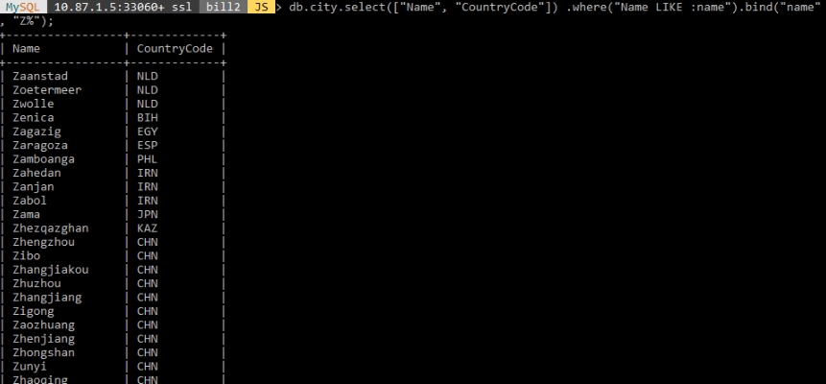
Filter Searches

Slide 25
Filter Searches - Binding
Tip
Within a program, binding enables you to specify placeholders in your expression
These are filled in with values before execution and can benefit from automatic escaping, as appropriate
Always use binding to sanitize input
Avoid introducing values in queries using string concatenation, which can produce invalid input and in some cases cause security issues

Slide 26
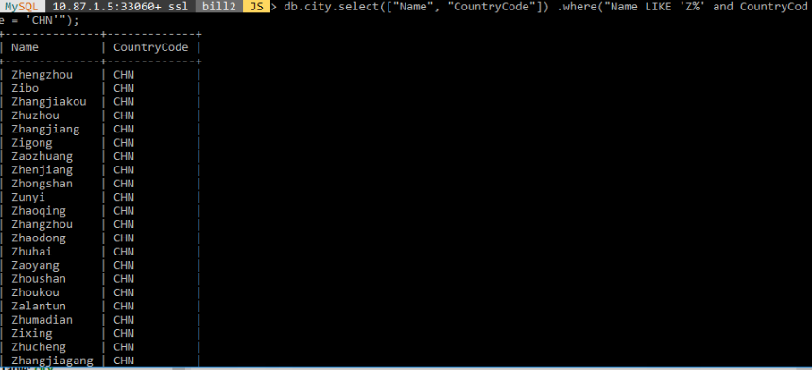
Project Results
To use a query using the AND operator, add the and operator between the search conditions in the where() method.

Slide 27
Project Results
To specify multiple conditional operators, you can enclose the search conditions in parenthesis to change the operator precedence
The following example shows the placement of the AND, and OR operators

Slide 28
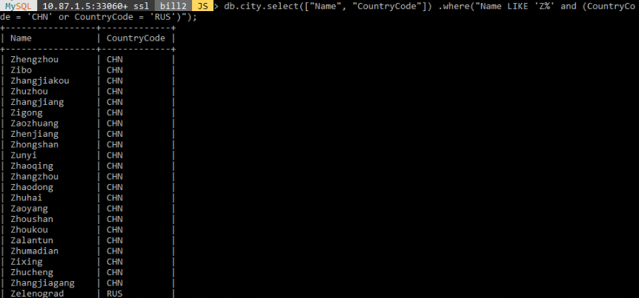
Project Results

Slide 29
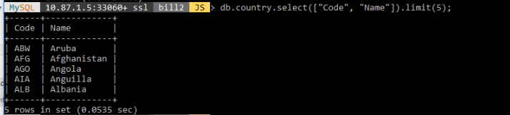
Limit, Order, and Offset Results
You can apply the limit(), orderBy() and offset() methods to manage the number and order of records returned by the select() method
To specify the number of records included in the result set, append the limit() method with a value to the select() method
The query shown returns 5 records in the country table using the limit() method

Slide 30
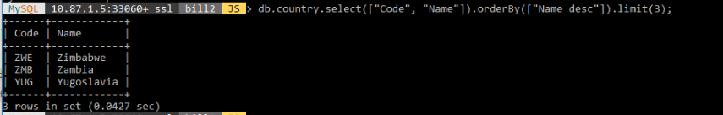
Limit, Order, and Offset Results
To specify the order for the results, append the orderBy() method to the select() method
Pass to the orderBy() method a list of one or more columns to sort by and, optionally, the desc for descending or the asc for ascending attribute as appropriate
Ascending order is the default order type
The following query sorts the records by the Name column and then returns the first 3 records

Slide 31
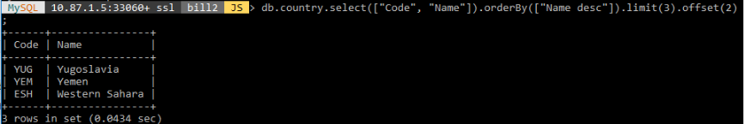
Limit, Order, and Offset Results
By default the limit() method starts from the first record in the table
The offset() method can be used to change the starting record
Ignore the first 2 records and return the next three records matching the condition
Pass to the offset() method a value of 2

Slide 32
Update Tables
You can use the update() method to modify one or more records in a table
The update() method works by filtering a query to include only the records to be updated and then applying the operations you specify to those records
To replace a city name in he city table, pass the set() method the new city name
Then pass the where() method the city name to locate and replace
The following example replaces the city Peking with Beijing
On the next slide the initial value is shown, followed by the update then the changed record to confirm is shown

Slide 33
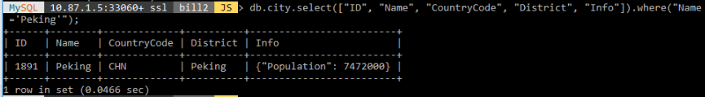
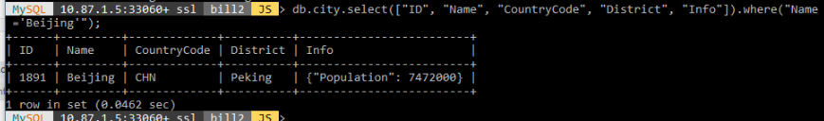
Update Tables

Slide 34
Delete Tables
You can use the delete() method to remove some or all the records from a table in a database
The X DevAPI provides additional methods to use with the delete() method to filter and order the records to be deleted

Slide 35
Delete Records Using Conditions
The following example passes search conditions to the delete() method
All records matching the condition are deleted from the city table
Our example will show one record matching the condition

Slide 36
Delete the First Record
To delete the first record in the city table, use the limit() method with a value of 1

Slide 37
Delete All Records
You can delete all records in a table
To do so use the delete() method without specifying any search condition
Use care when you delete records without specifying a search condition, doing so deletes all records from the table

Slide 38
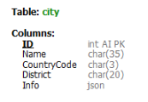
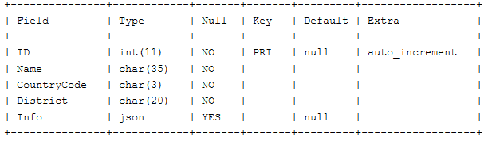
Documents in Tables
In MySQL a table may contain traditional relational data, JSON values or both
You can combine traditional data with JSON documents by storing the documents in columns having a native JSON data type
The city table you added to your schema are used for this example

Slide 39
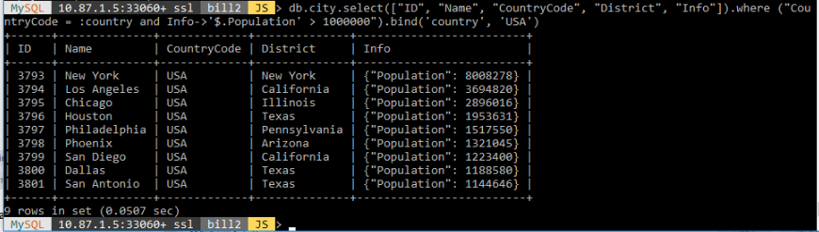
Select a Record
You can issue a query with a search condition that evaluates document values in the expression

Slide 40
Viewing Document Store in Workbench
You can use Workbench to see columns that contain JSON data
These details will display with regular table attributes

Slide 41
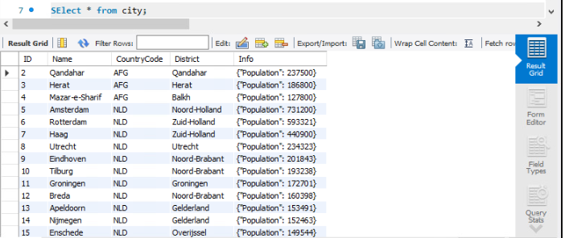
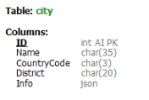
Column with JSON Data
The INFO column contains a key:value pair with population details stored

Slide 42
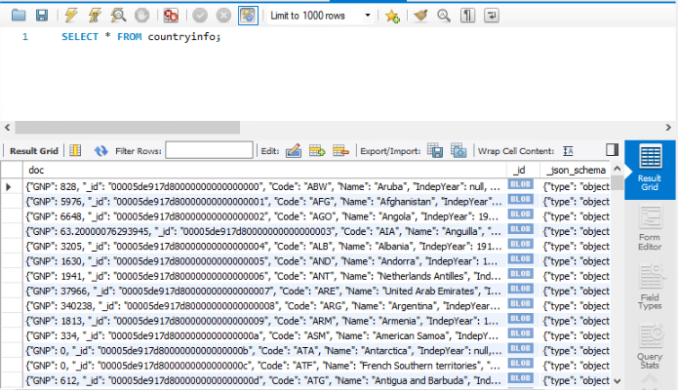
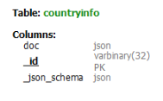
Full Document Store
This is a document store viewed with Workbench

